Slide 1
E-Commerce OLTP application Platform
Team Data Mavericks
Sayantika Pal
Tanvi Inchanalkar
Soumya Nayak
Anup Pote

Slide 2
Problem Statement
The issue we aim to address is the growing demand for online shopping, driven by the need to streamline inefficient transactions, maintaining complex product management, ensure real-time inventory updates, and simplify payment transactions.

Slide 3
Objective
Our objective is to develop an innovative E-commerce OLTP (Online Transaction Processing) platform that seamlessly caters to the surging demand for online shopping. This platform will prioritize enhancing transaction efficiency, simplifying the maintenance of complex product management, enabling real-time inventory updates, and ensuring effortless payment transactions.

Slide 4
Business Problem
Online shopping is in high demand, but there are several critical issues that need to be resolved:
Time consuming transaction processing leads to delays and customer dissatisfaction, which can hurt revenue and trust.
Complex product management overwhelms the business making it difficult to find and sell products.
Real-time inventory management is essential to avoid stockouts.
Streamlined payment transactions are necessary to build customer trust and encourage online shopping.

Slide 5
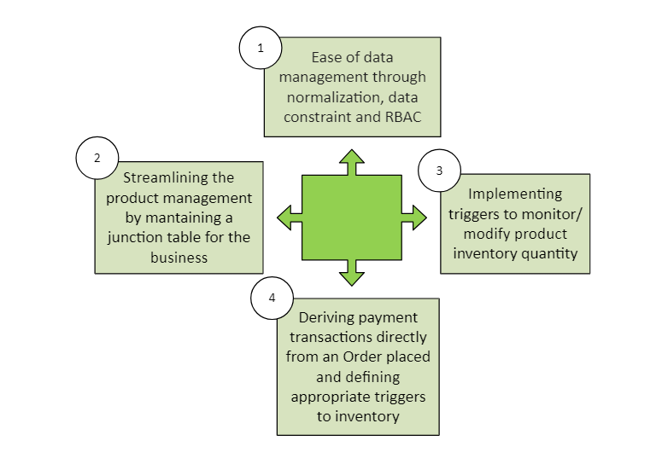
Proposed Solution

Slide 6
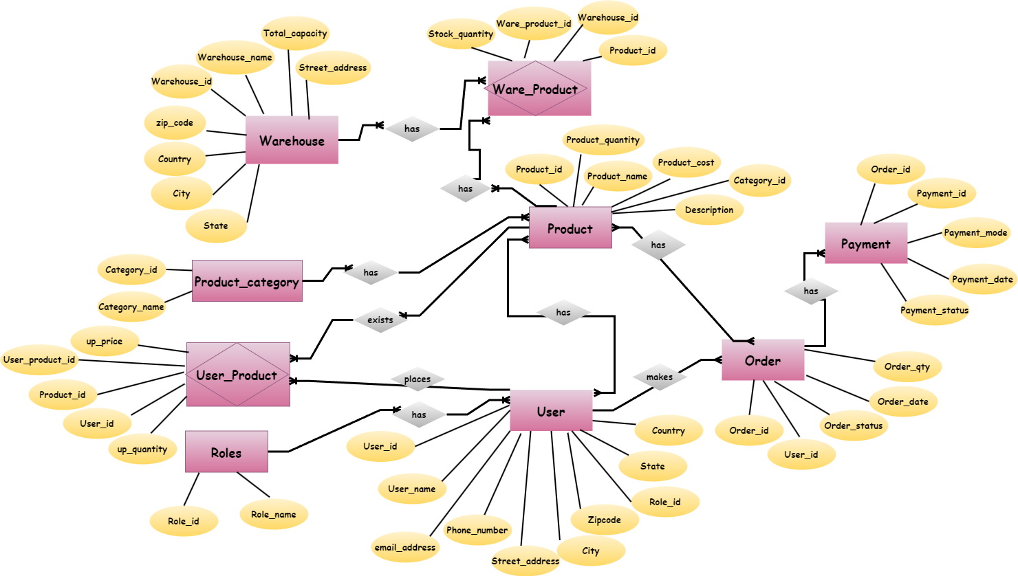
ER Diagram

Slide 7
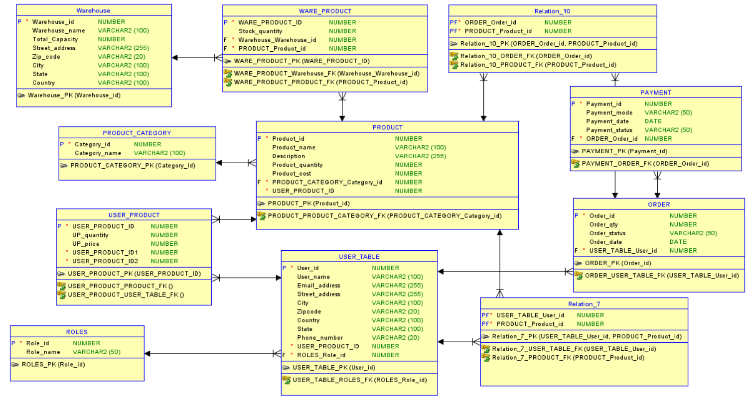
Relational Diagram

Slide 8
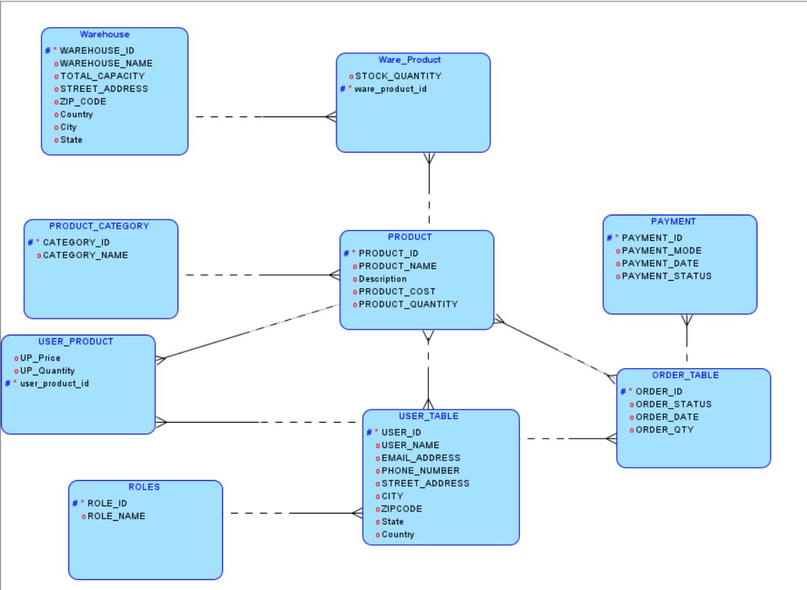
Logical Diagram

Slide 9
Attributes and Datatypes
USER
User_id(Primary Key): NUMBER
Role_id(Foreign Key): NUMBER
User_name: VARCHAR2(100)
Email_address: VARCHAR2(255)
Phone_number: VARCHAR2(20)
Street_address:VARCHAR2(255)
City VARCHAR2(100)
Zipcode VARCHAR2(20)
Country VARCHAR2(100)
State VARCHAR2(100)
ROLE
Role_id(Primary Key): NUMBER
Role_name: VARCHAR2(50)
PRODUCT
Product_id(Primary Key): NUMBER
Category_id(Foreign Key): NUMBER
Product_name: VARCHAR2(100)
Description: VARCHAR2(255)
Product_cost: NUMBER
Product_quantity: NUMBER
USER_PRODUCT
USER_PRODUCT_ID(Primary Key): NUMBER
Product_id(Foreign Key): NUMBER
Order_id(Foreign Key): NUMBER
UP_quantity: NUMBER
UP_price: NUMBER
PRODUCT CATEGORY
Category_id: NUMBER
Category_name: VARCHAR2(100)

Slide 10
Attributes and Datatypes
ORDER
Order_id(Primary Key): NUMBER
Order_status: VARCHAR2(50)
User_id(Foreign Key): NUMBER
Order_date: DATE
Order_qty: NUMBER
PAYMENT
Payment_id(Primary Key): NUMBER
Order_id(Foreign Key): NUMBER
Payment_mode: VARCHAR2(50)
PaymentCost: NUMBER(10,2)
Payment_status: VARCHAR2(50)
WAREHOUSE
Warehouse_id(Primary Key): NUMBER
Warehouse_name: VARCHAR2(100)
Total_Capacity NUMBER
Street_address VARCHAR2(255)
Zip_code VARCHAR2(20)
City VARCHAR2(100)
State VARCHAR2(100)
Country VARCHAR2(100)
WARE_PRODUCT
Warehouse_id(Foreign Key): NUMBER
Product_id(Foreign Key): NUMBER
Stock_quantity: NUMBER
WARE_PRODUCT_ID(Primary Key): NUMBER

Slide 11
Roles
Admin Role
Product Manager Role
Inventory Manager Role
Customer Role

Slide 12
Procedures
add_role : Adds a new role with a check for existence.
add_product_category : Adds a product category with existence check.
add_warehouse : Adds a warehouse with an existence check.
add_product : Adds a product with an existence check.
add_ware_product : Adds a product to a warehouse with stock quantity.
add_user : Adds a user with a check for name or email existence.
add_order : Adds a user order with a status check.
add_user_product : Adds a product to a user's order with quantity.
add_payment : Adds a payment for an order with mode and status, checking for completion status and duplicates.

Slide 13
Views
VW_USER_PRODUCT : View representing the USER_PRODUCT table.
VW_PAYMENT : View representing the PAYMENT table.
VW_ORDER_TABLE : View representing the ORDER_TABLE table.
VW_USER_TABLE : View representing the USER_TABLE table.
VW_WARE_PRODUCT : View representing the WARE_PRODUCT table.
VW_PRODUCT : View representing the PRODUCT table.
VW_PRODUCT_CATEGORY : View representing the PRODUCT_CATEGORY table.
VW_ROLES : View representing the ROLES table.
VW_WAREHOUSE : View representing the WAREHOUSE table.
customer1_view : View representing orders for Customer 1 (user_id = 2).
customer2_view : View representing orders for Customer 2 (user_id = 3).

Slide 14
Triggers and Package
trg_order_completed Trigger: Automatically updates product quantities when an order is marked as 'Completed' in the ORDER_TABLE.
trg_payment_completed Trigger: Updates the ORDER_TABLE when a payment is marked as 'Completed' in the PAYMENT table.
manage_stock_quantity Trigger: Manages stock quantity in the ware_product table based on changes in the product table, ensuring product availability.
my_package Package: Implements a global recursion flag variable to prevent trigger recursion conflicts.

Slide 15
Reports
Order Fulfillment Report
Customer Purchase History Report
Total overall revenue Report
Inventory out of stock Report
Product Sales Report
Payment status report

Slide 16
Team’s Contribution
Sayantika Pal
Tanvi Inchanalkar
Created PL/SQL package to declare and initialize global variable
Created PL/SQL procedures for insertions into ware_product table, updated procedures and handled appropriate exceptions
Created trigger to handle product restock from ware_product table
Creation of test script for customer 1 and E2E script testing. Created reports using joins
Created PL/SQL procedures for insertions into role, order and user_product table and handled appropriate exceptions
Created trigger to handle subtraction of products from inventory after successful order placement
Created reports that also involves view, function creation
Created test script for customer 2
Anup Pote
Soumya Nayak
Created PL/SQL procedures for insertions into Product, Product_category and Payment and handled appropriate exceptions
Created trigger to handle update of order status and quantity after Payment is completed
Created reports that summarizes order fulfillment for a user.
Created test script for customer 1
Created PL/SQL procedures for insertions into user, warehouse table and handled appropriate exceptions
Created reports using table joins
Created 2 customer specific views for order details
Created test script for customer 2
Created table specific views

Slide 17
THANK YOU!

